Slide 1
Lecture 14 – Class Structuring & Task Interface and Behavior Specifications
COMP 3700: Modeling and Design
Chapters 14 & 18: Designing Object-Oriented Software Architectures & Designing Concurrent and Real-Time Software Architectures
Gomaa, 2011

Slide 2
Steps for developing the Concurrent Task Architecture
Begin with the analysis model (integrated communication diagram)
In each case, decide whether the analysis model object should be designed as an active object (task) or a passive object in the design model
NOTE: It is possible to have multiple tasks of the same type
Determine I/O tasks
Start with the device I/O objects that interact with the outside world. Determine whether the object should be structured as an event driven I/O task, a periodic I/O task, or a demand driven I/O task
Determine Control tasks
Analyze each state dependent control object and coordinator object. Structure this object as a (usually demand driven) state-dependent control or coordinator task
Determine Periodic tasks
Analyze the internal periodic activities, which are structured as periodic tasks
Handle Other internal tasks
For each internal task activated by an internal event, structure this task as a demand driven task
Re-draw initial concurrent communication diagram showing all the tasks in the system
NOTE: The interfaces between the tasks are still simple messages as depicted on the analysis model integrated communication diagram

Slide 3
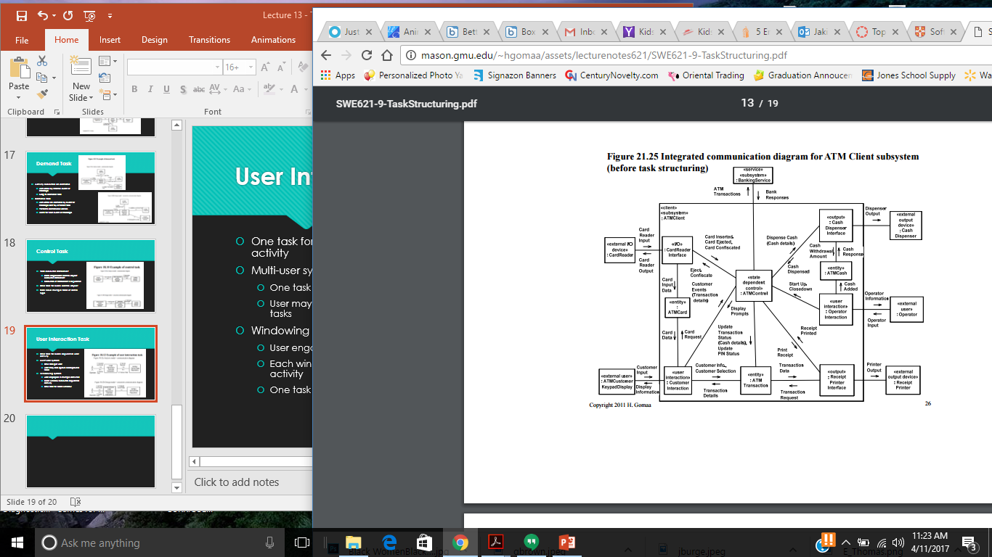
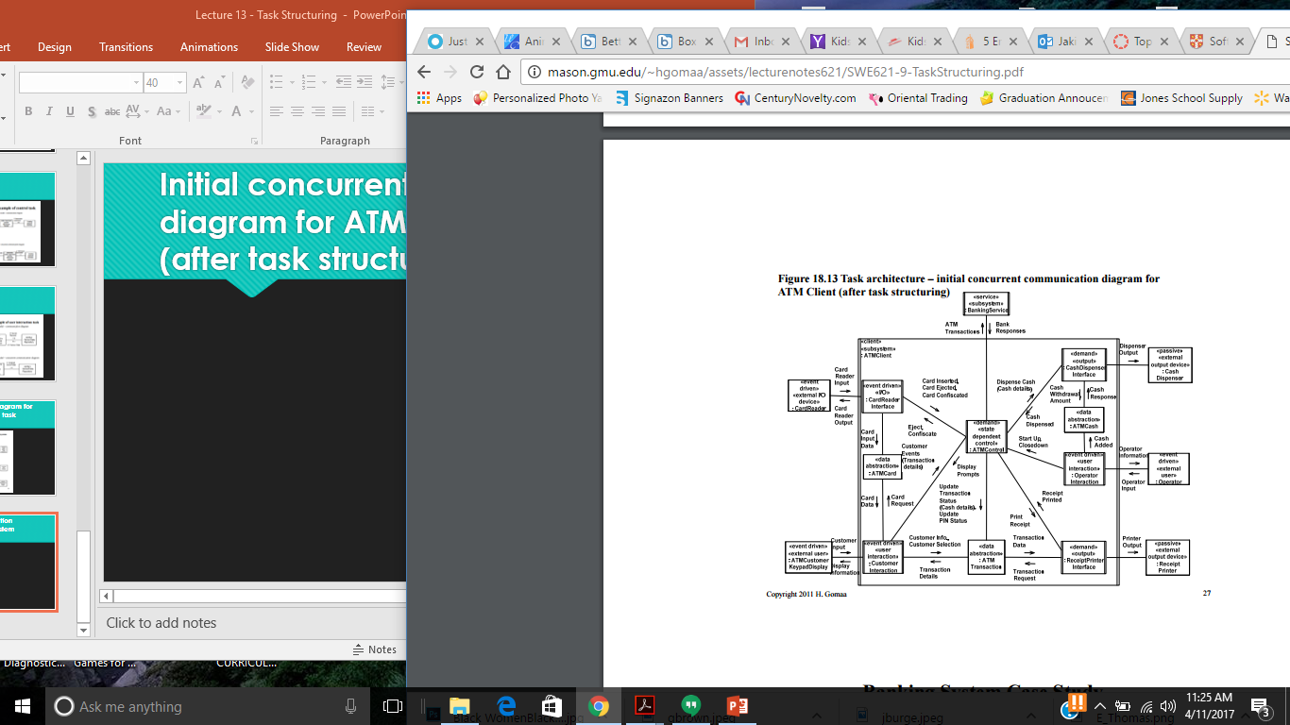
Integrated communication diagram for ATM Client subsystem (before task structuring)

Slide 4
Initial concurrent communication diagram for ATM Client subsystem (after task structuring)
NOTE
Active objects are identified
Task structuring criteria are applied (using stereotypes)
Internal task structuring criteria are applied (using stereotypes)

Slide 5
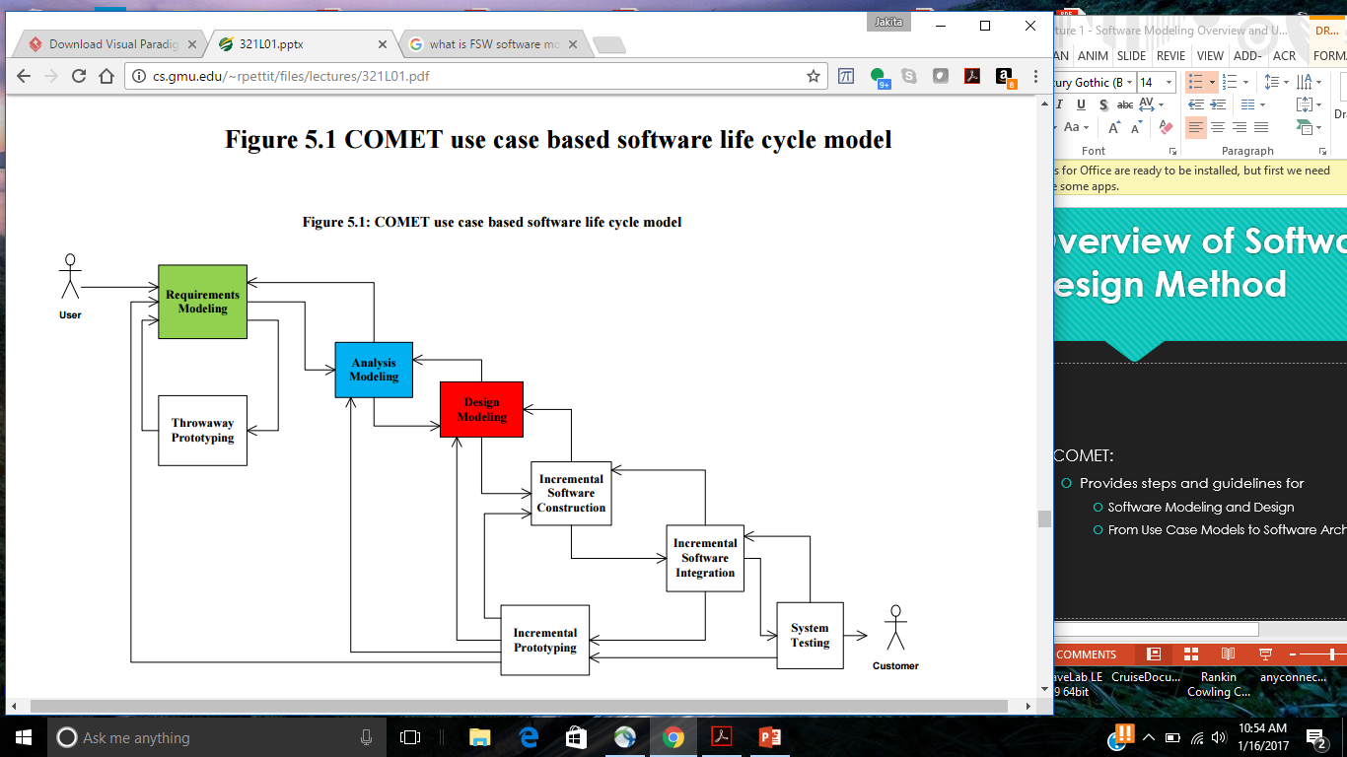
COMET Use Case Based Software Life Cycle Model
Develop Software Requirements Model
Develop Software Analysis Model
Develop Software Design Model
Design Overall Software Architecture (Chapter 12, 13)
Design Distributed Component-based Subsystems (Chapter 13, 15)
Structures Subsystems into Concurrent Tasks (Chapter 18)
Design Information Hiding Classes (Chapter 14)
Design Detailed Software Design

Slide 6
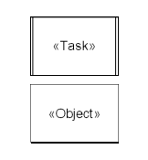
Active and Passive Objects
Objects may be active or passive
Active object
Concurrent Task
Has thread of control
Also called a process or thread
Passive object
Information Hiding Object
Has no thread of control
Operations of passive object are executed by task
Operations execute in tasks’s thread of control
Directly or indirectly
Software Design terminology
Task refers to active object
Object refers to passive object

Slide 7
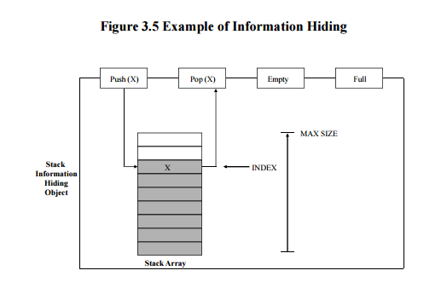
Example of Information Hiding
Example of Stack object
Information hiding solution
Hide stack data structure and internal linkage
Specify operations on stack data structure
Access to stack only via operations
Push (x), pop (x), empty, full
Consider
Array implementation changed to Linked list implementation
Change to stack only implies Stack object
Interface unchanged
Implementation (internals) modified

Slide 8
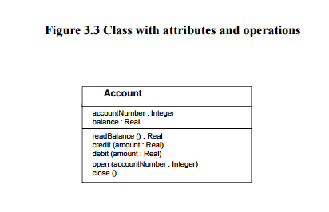
Classes and Operations
Class
Represents a collection of identical objects (instances)
Described by means of attributes (data items)
Has one or more operations to access internal data
Each object instance can be uniquely identified
Operation (also known ass method)
Function or procedure that manipulates values of attributes maintained by object
All objects in class have same operations

Slide 9
Design Class Operations
Design Class Operations from Communication Model
Shows direction of message from sender object to receiver object
Design Class Operations from Finite State Machine Model
Statechart actions are mapped to operations
Design Class Operations from Static Model
May be used for entity classes
Standard operations
Create, Read, Update, Delete
Specific operations
Based on services provided by class

Slide 10
Information Hiding Class Structuring
Class Design
Initially determined from Analysis Model
Each class hides design decision
Design of Information Hiding Classes
Entity classes are categorized further
Data abstraction classes
Database wrapper classes
Design class operations
Primarily from communication model
Shows direction of message from sender object to receiver object

Slide 11
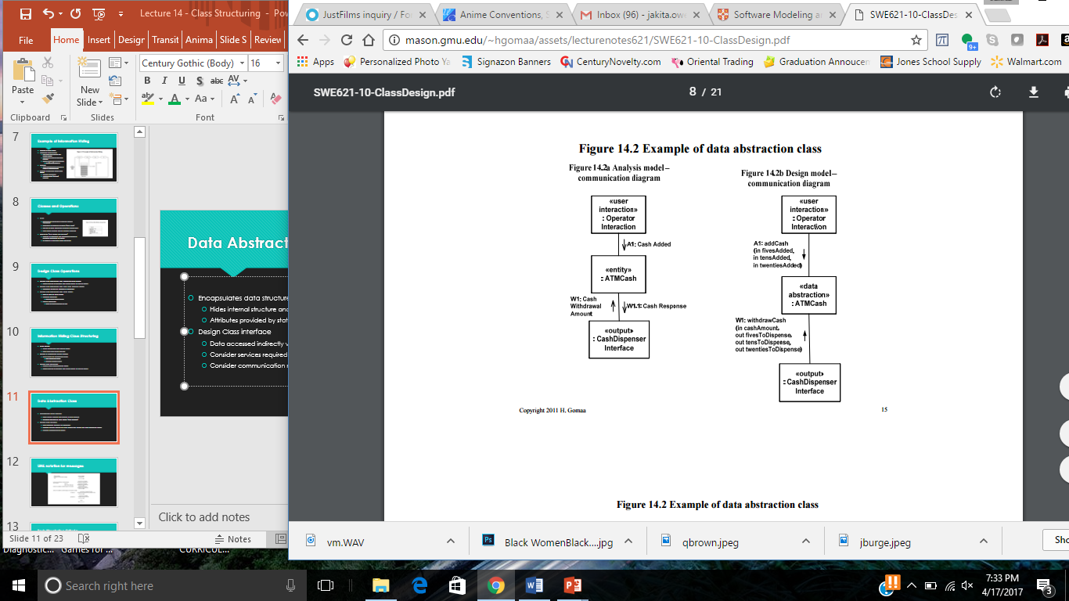
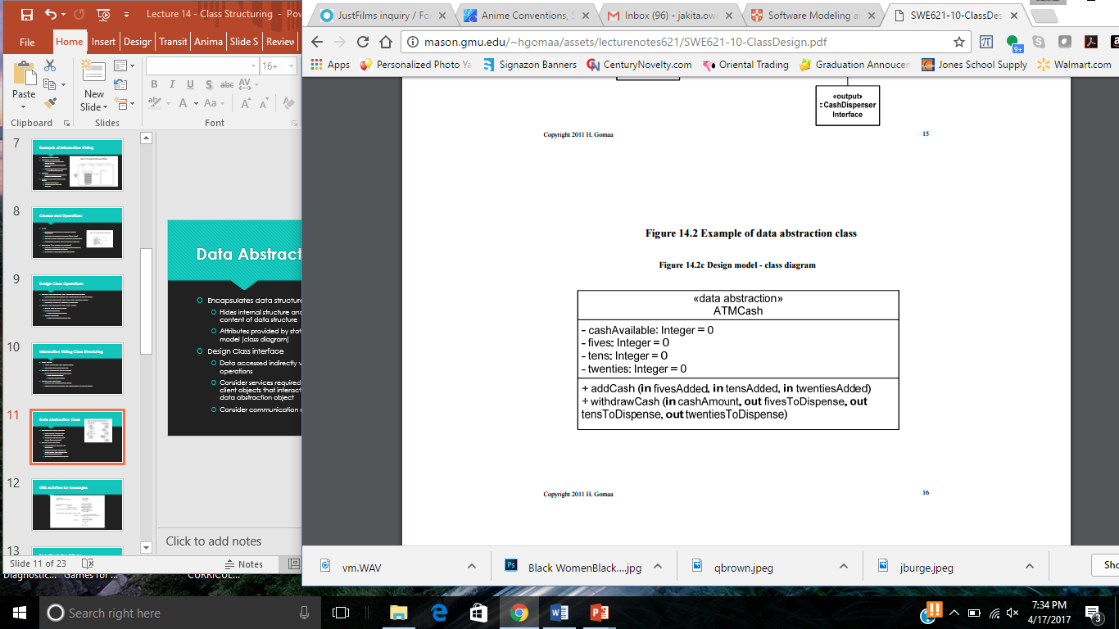
Data Abstraction Class
Encapsulates data structure
Hides internal structure and content of data structure
Attributes provided by static model (class diagram)
Design Class interface
Data accessed indirectly via operations
Consider services required by client objects that interact with data abstraction object
Consider communication model

Slide 12
State Machine Class
Hides contents of statechart/state transition table
Maintains current state of object
Process Event Operation
Called to process input event
Depending on current state and conditions
Might change state of object
Might return action(s) to be performed
Current State Operation
Returns the state stored in state transition table
If state transition table changes only this class is impacted

Slide 13
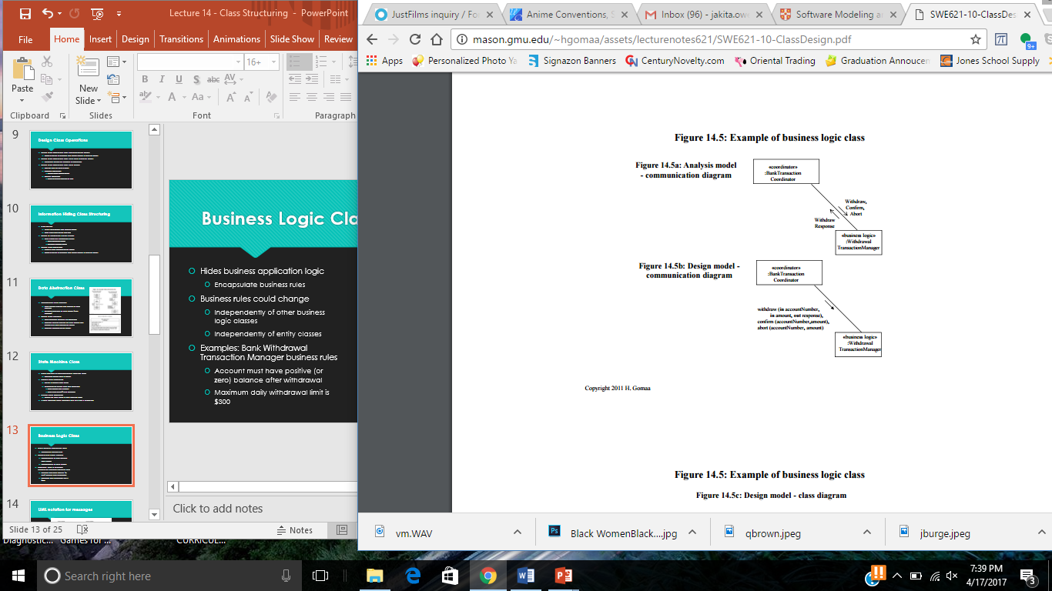
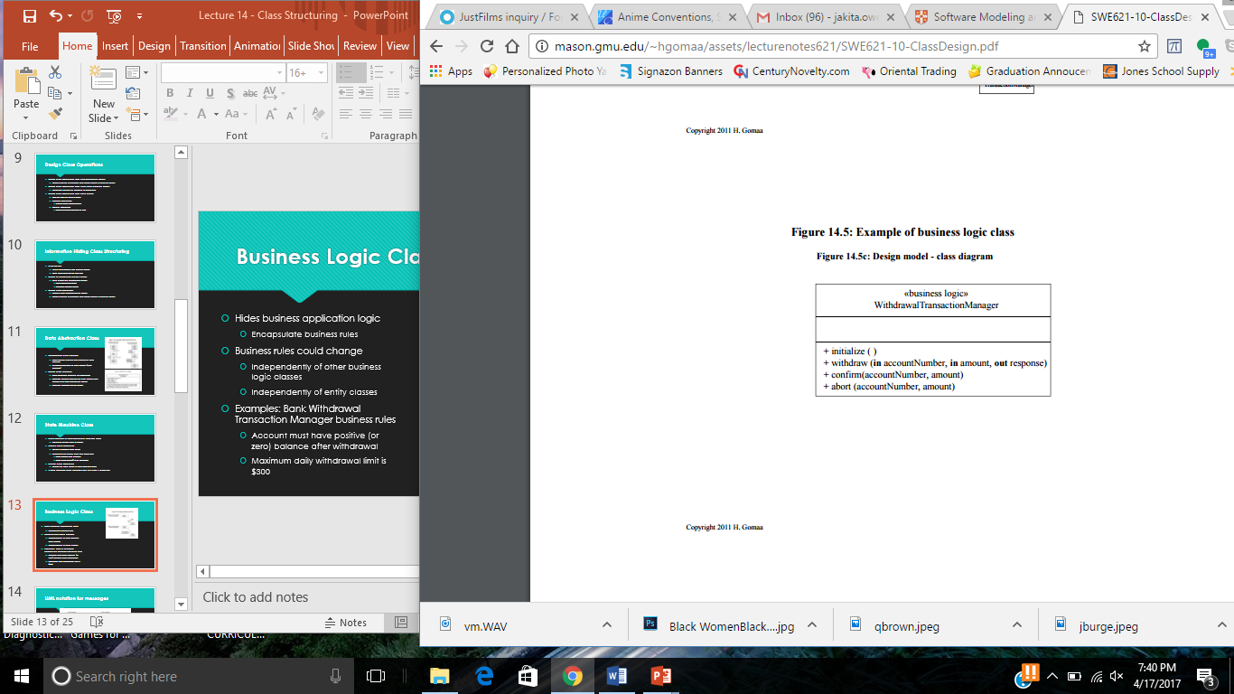
Business Logic Class
Hides business application logic
Encapsulate business rules
Business rules could change
Independently of other business logic classes
Independently of entity classes
Examples: Bank Withdrawal Transaction Manager business rules
Account must have positive (or zero) balance after withdrawal
Maximum daily withdrawal limit is $300

Slide 14
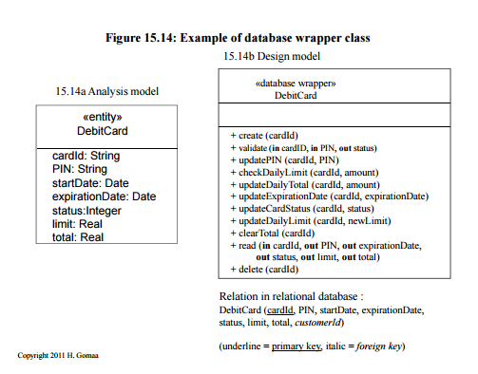
Database Wrapper Class
Entity class in Analysis Model
Encapsulated data is actually stored in database
Analysis Model class mapped to
Database Wrapper Class
Hides interface to database (e.g., relational)
Attributes of class mapped to
Relation (flat file) stored in database
Database Wrapper Class
Provides OO interface to database
Hides details of how to access data in database
Hides SQL statements
May hide details of one relation
Database view (join of two or more relations)

Slide 15
Inheritance in Design
Subclass inherits generalized properties from superclass
Property is Attribute or Operation
Inheritance
Allows sharing of properties between classes
Allows adaptation of parent class (superclass) to form child class (subclass)
Subclass inherits attributes & operations from superclass
May add attributes
May add operations
May redefine operations

Slide 16
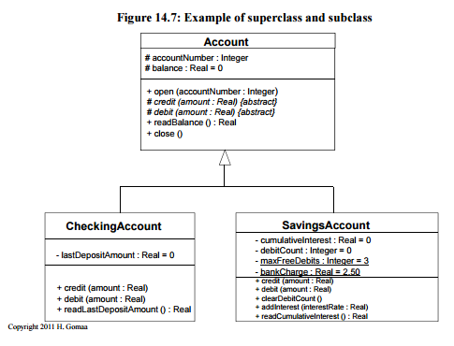
Example of Inheritance
Attributes of Account Superclass
accountNumber, balance
Operations of Account Superclass
open (accountNumber : Integer)
close ()
readbalance () : Real
credit (amount : Real) {abstract}
debit (amount : Real) {abstract)

Slide 17
Example of Inheritance
Attributes of Checking Account Subclass
Inherits accountNumber, balance
Adds lastDepositAmount
Operations of Checking Account Subclass
Inherits specification and implementation of open, readBalance, close
Inherits specification of credit and debit but defines implementation
Adds readLastDepositAmount () : Real

Slide 18
Example of Inheritance
Attributes of Savings Account Subclass
Inherits accountNumber, balance
Adds instance attributes cumulativeInterest, debitCount
Adds static class attributes maxFreeDebits, bankCharge
Operations of Savings Account Subclass
Inherits specification & implementation of open, readBalance, close
Inherist specification of credit and debit but defines implementation
Debit
Debit balance
Deduct bankCharge if debitCount > maxFreeDebits
Adds operations
addInterest (interestRate) Add daily interest
readCumulativeInterest () : Real
clearDebitCount () Reinitialize debitCount to zero

Slide 19
Class Interface Specification
Defines the interface of the information hiding class, including the specification of the operations provided by the class
Information hidden by class
Class structuring criterion
Assumptions made in specifying class
Anticipated changes
Superclass (if applicable)
Inherited Operations (if applicable)
Operations provided by class
Function performed
Precondition
Postcondition
Invariant
Input parameters
Output parameters
Operations used by class (provided by other classes)

Slide 20
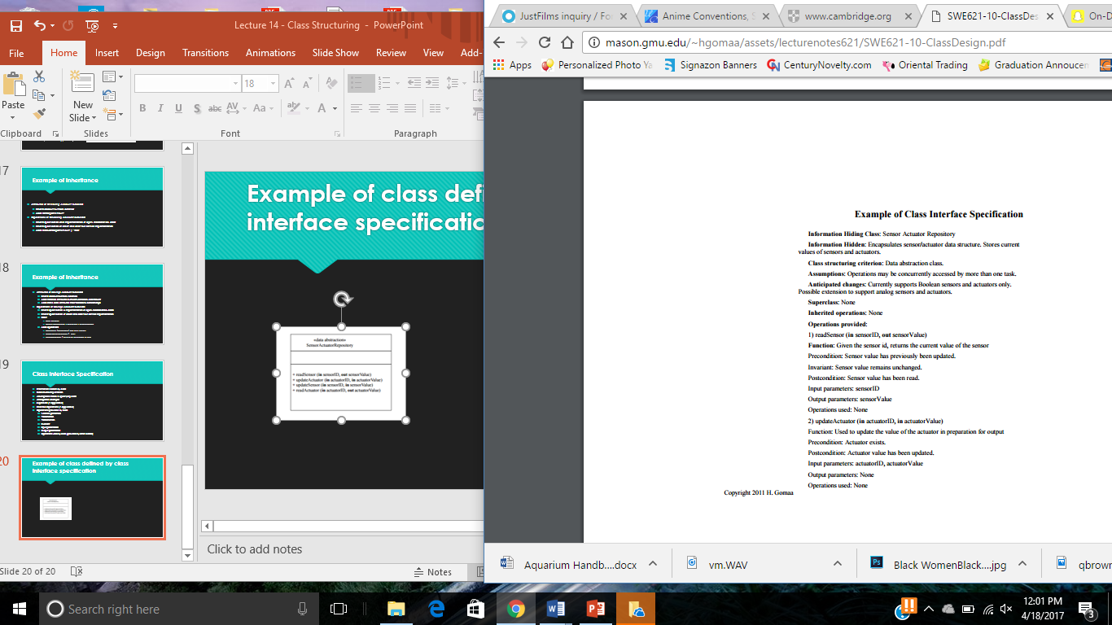
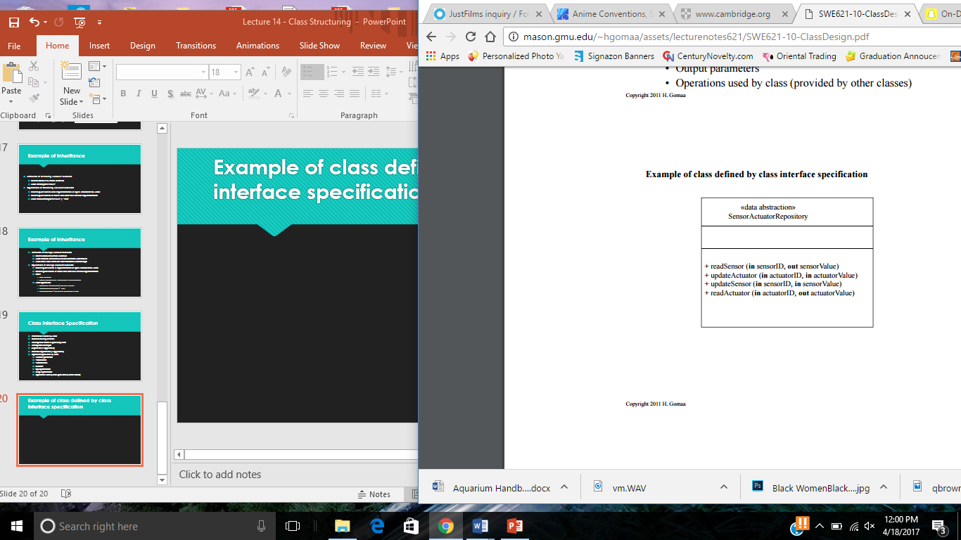
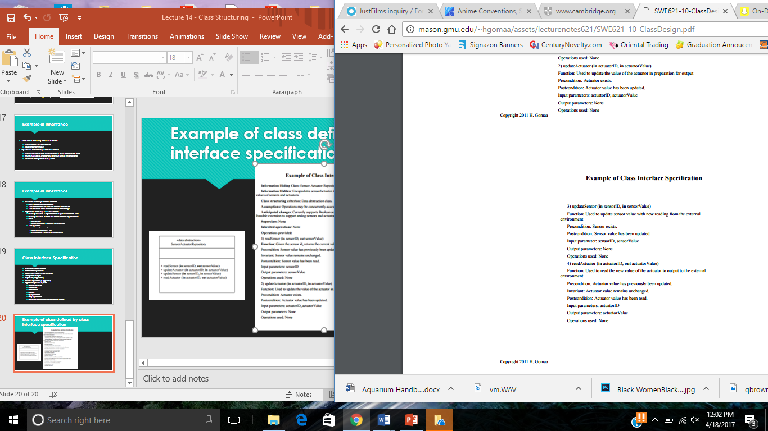
Example of class defined by class interface specification

Slide 21
ATM Client Subsystem – Information Hiding Class Categorization
Data Abstraction Class
ATM Card
ATM Transaction
ATM Cash
State Machine Class
ATM Control
Reference: Chapter 21

Slide 22
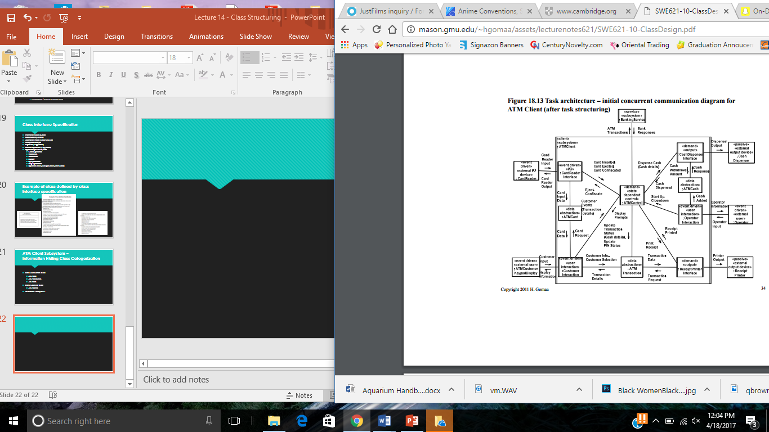
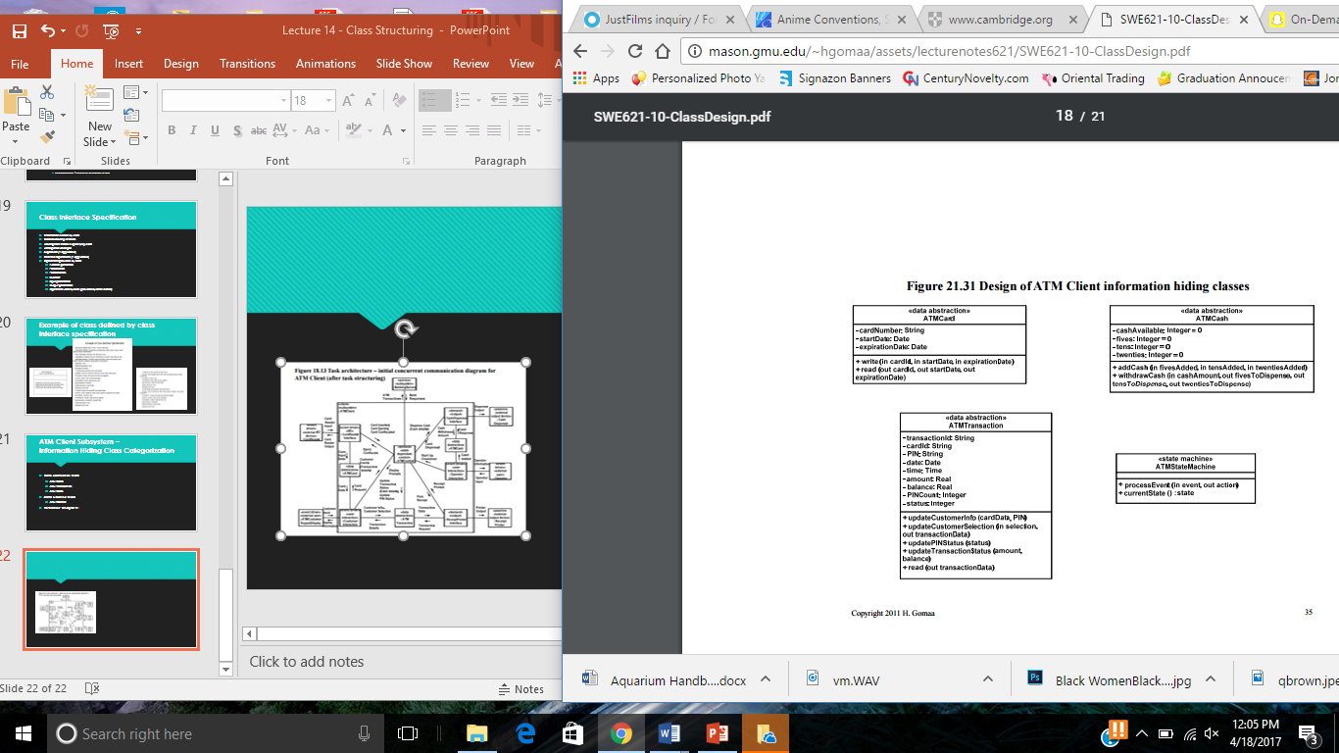
From Concurrent Communication Diagram to Design of Information Hiding Classes for ATM Client Subsystem

Slide 23
Bank Server Subsystem – Information Hiding Class Categorization
Business Logic Classes
Pin Validation Transaction Manager
Query Transaction Manager
Transfer Transaction Manager
Withdrawal Transaction Manager
Database Wrapper Classes
Checking Account
Savings Account
Debit Card
Card Account
Transaction Log
Reference: Chapter 21

Slide 24
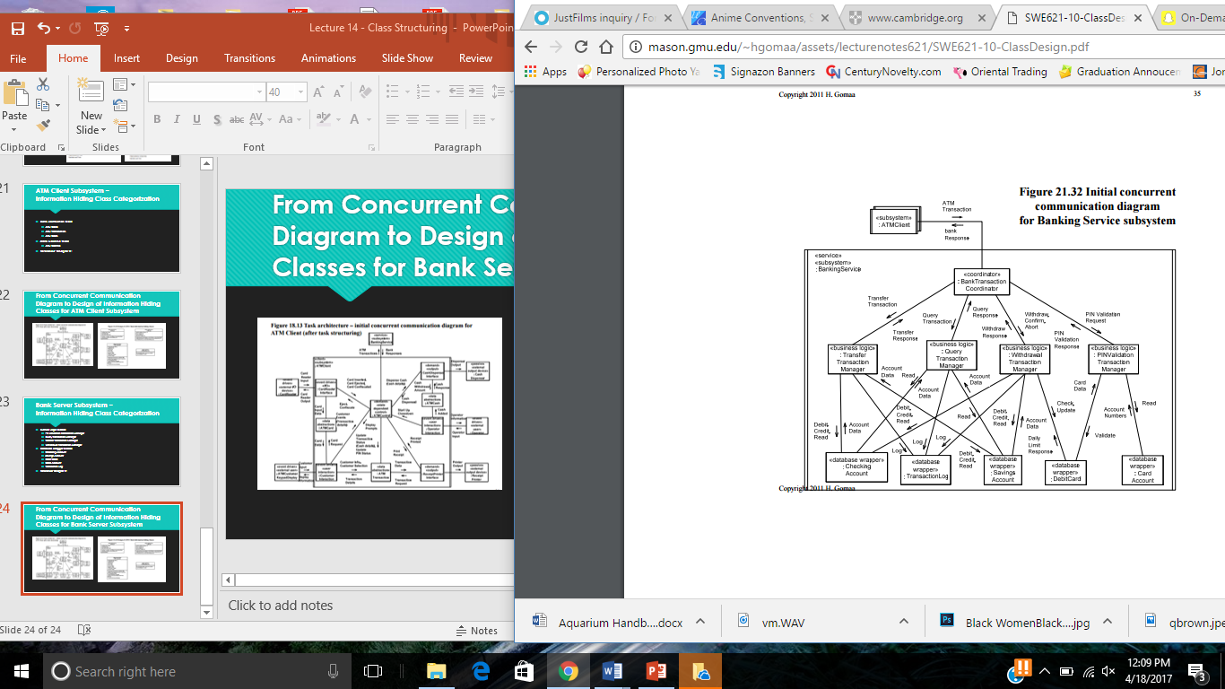
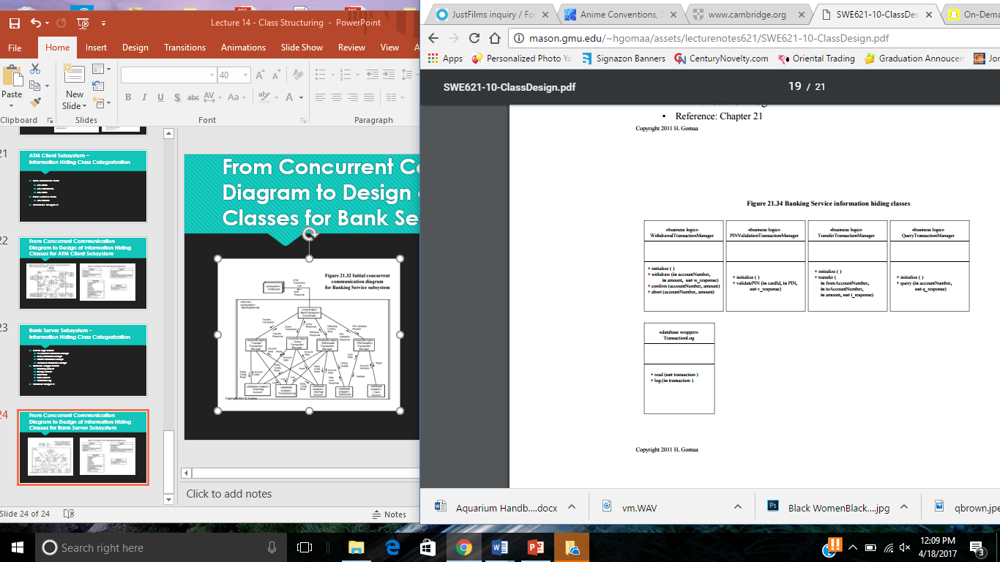
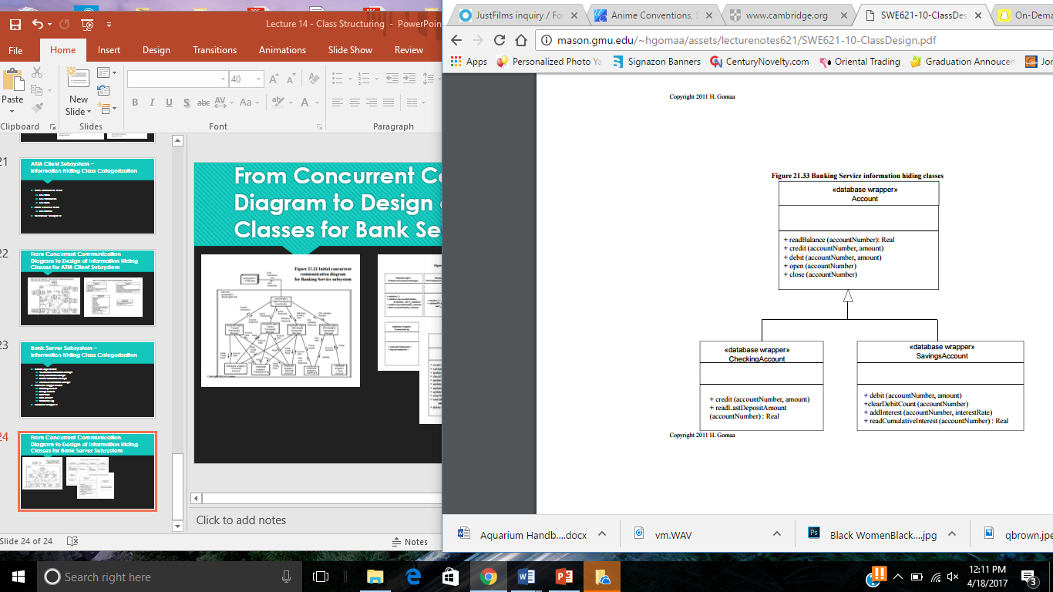
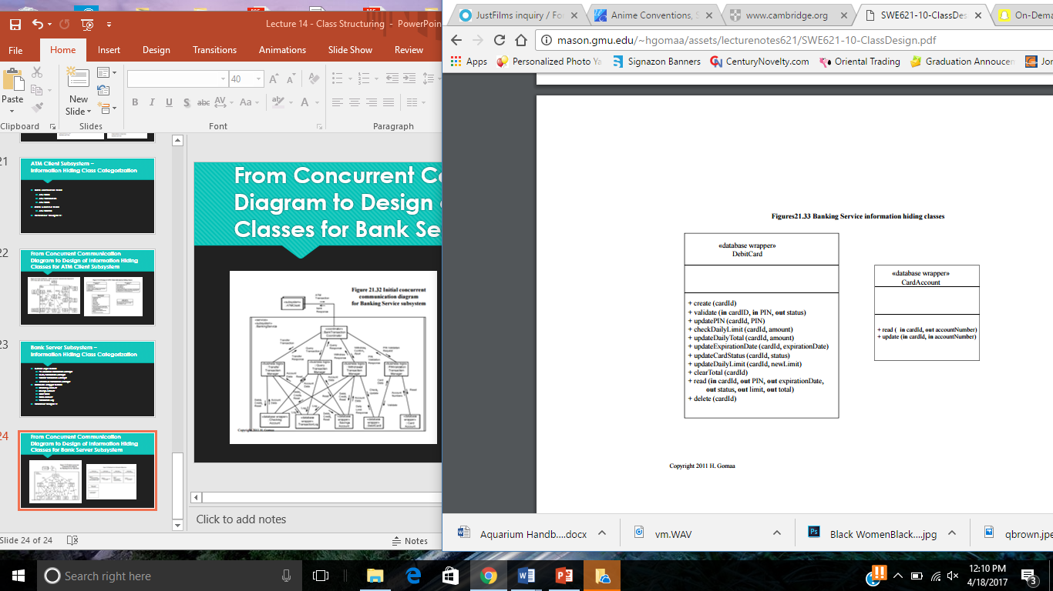
From Concurrent Communication Diagram to Design of Information Hiding Classes for Bank Server Subsystem

Slide 25
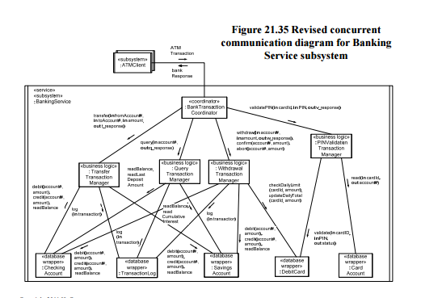
Revised Concurrent Communication Diagram for Banking Service Subsystem

Slide 26
COMET Use Case Based Software Life Cycle Model
Develop Software Requirements Model
Develop Software Analysis Model
Develop Software Design Model
Design Overall Software Architecture (Chapter 12, 13)
Design Distributed Component-based Subsystems (Chapter 13, 15)
Structures Subsystems into Concurrent Tasks (Chapter 18)
Design Information Hiding Classes (Chapter 14)
Design Detailed Software Design

